Slide 1




STUDENT DIGITAL PORFOLIO
STUDENT NAME : HARIHARAN R
STUDENT REGISTER ID : 24h219
NM EDUNET DASHBOARD USERID :
5AD34CDAF98EDE088744CA308A246B7D
DEPARTMENT : BCA - “C”
COLLEGE : AGURCHAND MANMULL JAIN COLLEGE
UNIVERSITY OF MADRAS

Slide 2


PROJECT TITLE
STUDENT DIGITAL
PORFOLIO

Slide 3
AGENDA
1.PROBLEM STATMENT
2. PROJECT OVERVIEW
3. END USERS
4. TOOLS AND TECHNOLOGIES
5. PORTFOLIO DESIGN AND LAYOUTS
6. FEATURES AND FUNCTIONALITY
7. RESULTS AND SCREENSHOTS
8. CONCLUSIONS
9. GITHUB LINK

Slide 4
PROBLEM STATEMENT
A digital portfolio is needed because it gives students one organized space to collect, reflect, and showcase their learning, skills, and achievements. Unlike marksheets or paper files, it shows the complete growth journey of a student what they learned, how they improved, and what they can actually do. It helps teachers track progress, students build confidence, and recruiters or universities see real abilities beyond grades. In today’s digital world, having an online portfolio is not just useful, it’s essential for personal branding, career opportunities, and lifelong learning.

Slide 5
PROJECT OVERVIEW
Brief Summary Of My Portfolio Project - My portfolio is a personal website designed to showcase my profile, technical skills, projects, and contact details in a professional and interactive way. It features a modern teal/blue gradient theme with glowing effects, an animated avatar photo, and smooth UI elements.
My PortFolio Contenst and Main idea - Header with Avatar 👤
About Me ✍️
Skills Section 💡
Projects 📑
Contact Me 📩
Footer 🔗

Slide 6
WHO ARE THE END USERS
Recruiters & Hiring Managers – People who want to quickly see my skills, projects, and contact info when considering me for internships or jobs.
2. Peers & Collaborators – Other students, developers, or teammates who might want to connect, collaborate, or get inspired by my work.
3. Teachers & Evaluators – Faculty members or mentors who review my projects as part of academics or assessments.

Slide 7
TOOLS AND TECHNIQUES
HTML – For structuring the content of your portfolio (About Me, Skills, Projects, Contact).
CSS – For styling, layout, gradients, animations, and responsive design.
JavaScript (JS) – For interactivity:
Animated skill progress bars
Contact form validation
Calculator functionality.
Code Editor (MicroSoft VS Code / Notepad++) – For writing and testing the code.
Web Browser (ZEN/MS Edge/) – For running and testing the portfolio.

Slide 8
PORTFOLIO DESIGN AND LAYOUT
About Me – A short introduction describing who am i, my passion, and career goals.
Skills – Animated progress bars showing your knowledge in Python, C++, JavaScript, and HTML & CSS.
Projects – A showcase of my work, including a built-in calculator made with HTML, CSS, and JavaScript.
Contact Me – A form where visitors can reach me, with validation to ensure emails include “@”.
Footer – A simple closing note with my name and current year.

Slide 9
FEATURES AND FUNCTIONALITY
Skills Section – Animated skill bars that visually represent my proficiency in Python, C++, JavaScript, and HTML & CSS.
Projects Section – Highlights my work, including an integrated Calculator project built with HTML, CSS, and JS.
Contact Form – A form for visitors to reach you with validation that ensures the email entered contains “@”.
Responsive Design – Works on desktops, tablets, and mobile devices.
Modern Styling – Uses a teal/dark gradient theme, hover animations, and glowing effects for interactivity.
Resume Download Button- To download my resume

Slide 10
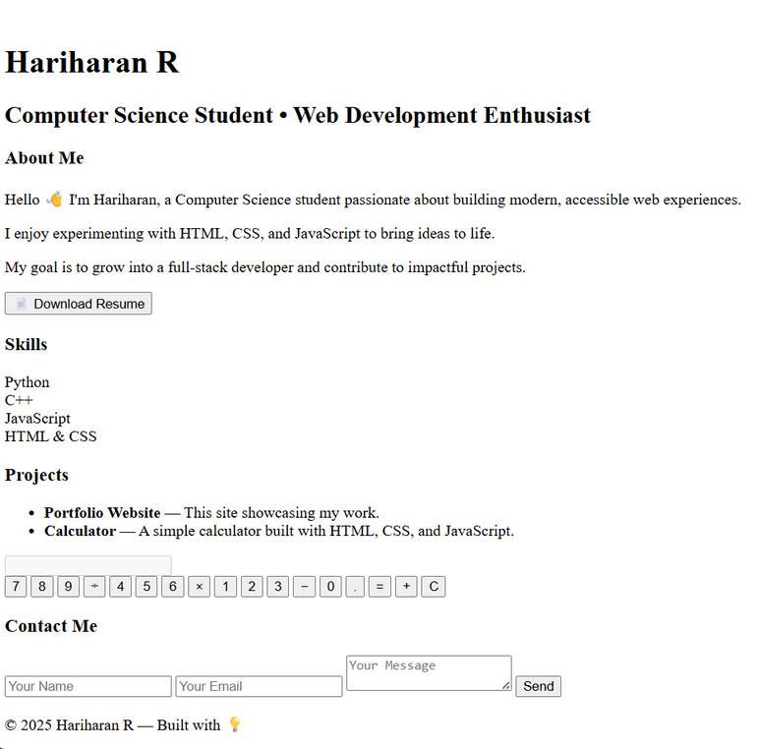
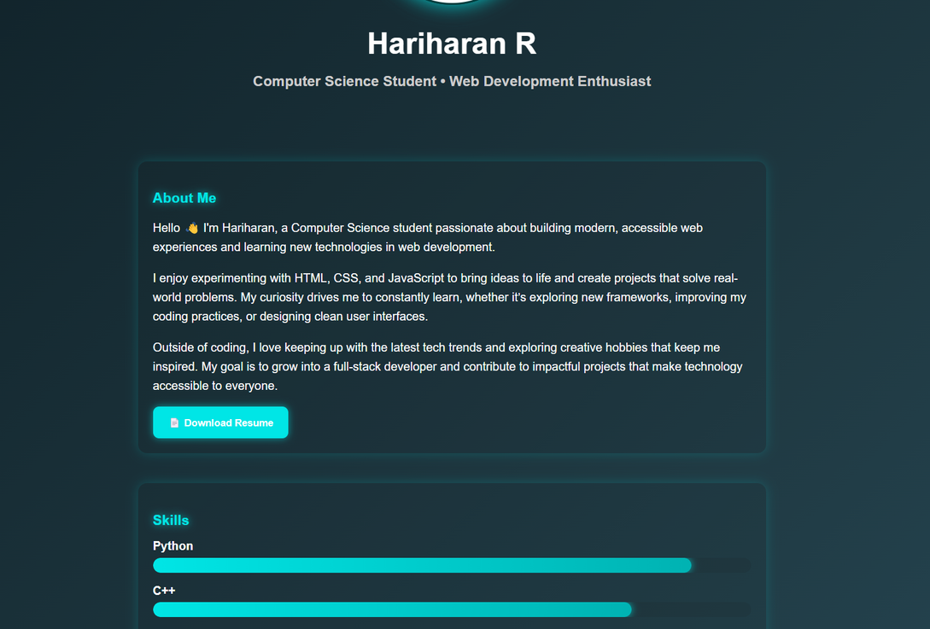
RESULTS AND SCREENSHOTS
SCREENSHOTS OF MY PORTFOLIO WEBPAGE
🠠 BEFORE AND AFTER ➝
SIMPLE HTML
AFTER ADDING HTML , CSS AND JS

Slide 11
CONCLUSION
The digital student portfolio provides a centralized platform to showcase skills, achievements, and growth beyond grades. It not only enhances learning and self-reflection but also improves opportunities for higher studies and career development.

Slide 12





GITHUB LINK
Server Link : https://github.com/HARIHARAN-R48/TNSDC-FWD-DigitalPortfolio.git
Deployment Link : https://hariharan-r48.github.io/TNSDC-FWD-DigitalPortfolio/

Slide 13
THANK
YOU

